Slide 1

‘FOM SMILE Mental Health & Wellbeing approach.’
What? Why? How?

Slide 2

The SMILE Approach
SMILE
est. Forest Oak School 2014
Socialise
Move
Interest
Learn
Engage
Adapted from the NHS ‘Five Ways to Mental Wellbeing’
Nef 2008
Connect
Be active
Take notice,
be mindful
Keep learning
Give to others

Slide 3
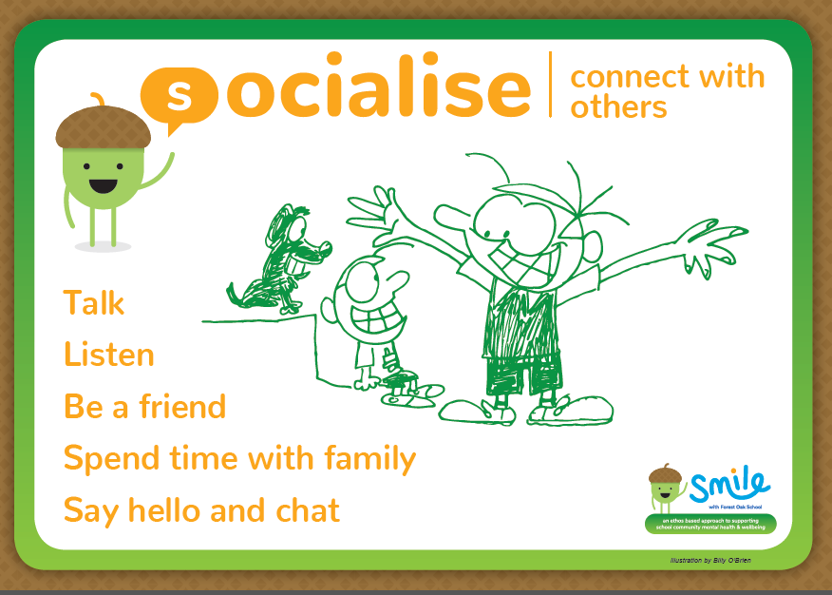

Slide 4
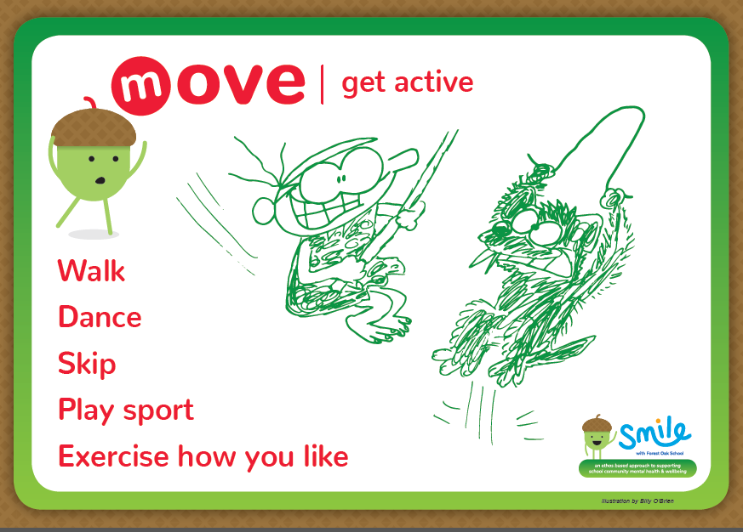

Slide 5
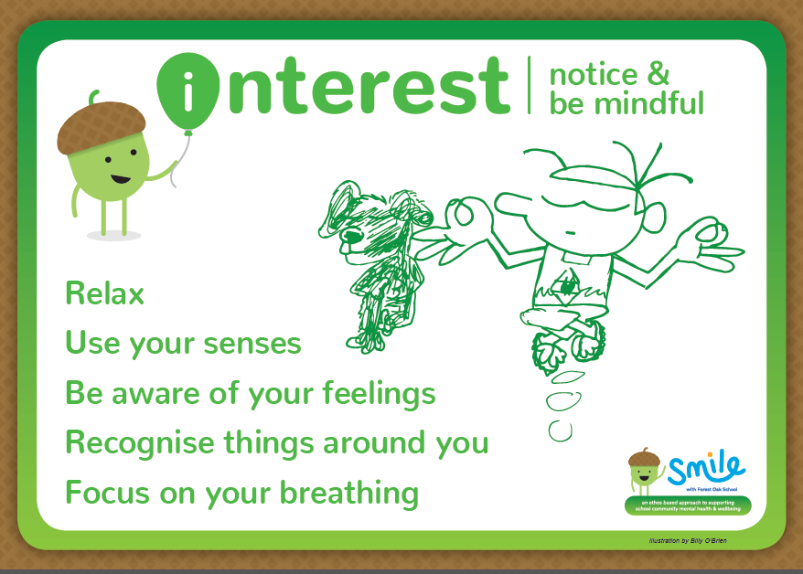

Slide 6
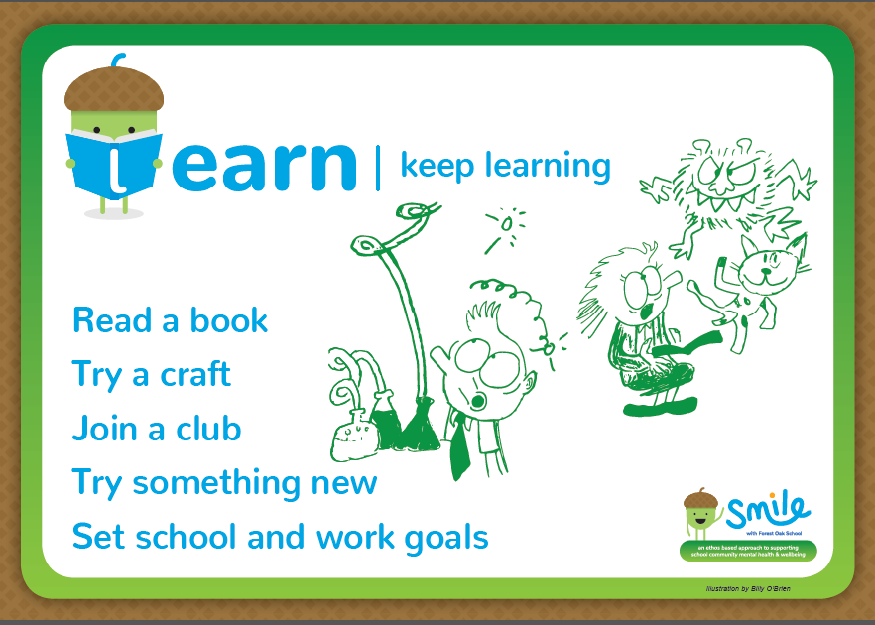

Slide 7
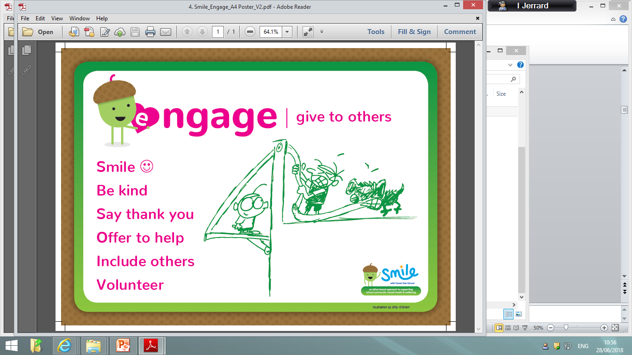

Slide 8
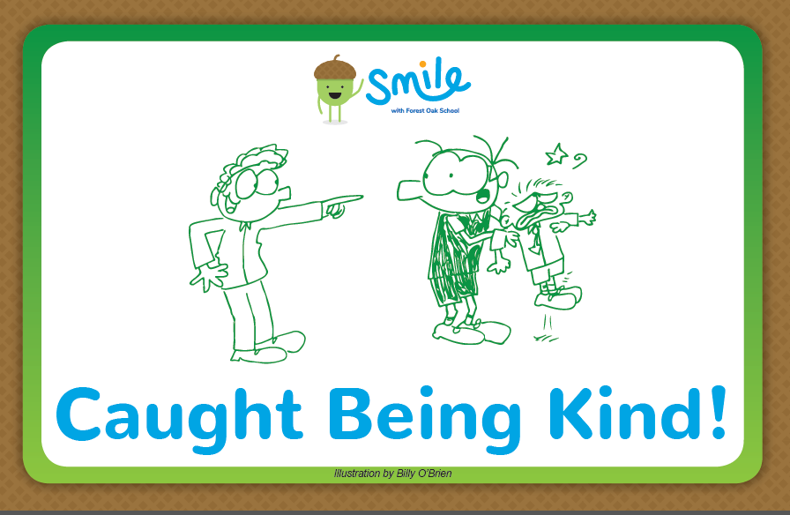

Slide 9
SMILE aim
“To empower our school communities (staff and students) to become ‘architects of their own emotional health and well-being’ within an enabling environment.”

Slide 10

Why Ethos based & whole school?
‘The national institute for health and care excellence advises schools adopt a whole school approach to promoting the social and emotional wellbeing of staff and pupils …it moves beyond learning and teaching to pervade all aspects of the life of a school… effective in bringing about and sustaining health benefits.’

Slide 11

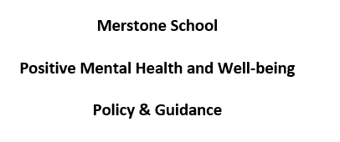

Our offer

